Slide 1

Topic: Paging
Lecture: Dr. Zhao Jie
Date: 03/02/2026

Slide 2
Reading Assignment
Chapters 18 & 20

Slide 3
Agenda
Fixed-size piece
Paging
VA-PA translation
Page Table Entry

Slide 4

Motivation of fixed-sized piece
Look at the following birthday cake. If the number of guests is growing and uncertain, how can you divide the birthday cake?
This is the reason that the fixed-size piece, not the variable-size piece, is used for virtual memory management.

Slide 5
Paging
The term “page” originated from the book pages. This means that when the book is published, the number of pages and the word counts on each page are fixed.
Paging: It is a mechanism, that is, for management, the OS chops the memory into fixed-size pieces.
Page: the fixed-size unit of virtual memory (address space). One page could have 16 bytes.
Page frame: the fixed-size unit of physical memory. One page could have 16 bytes.
However, you need to know that both the page size and the page frame must be equal.

Slide 6
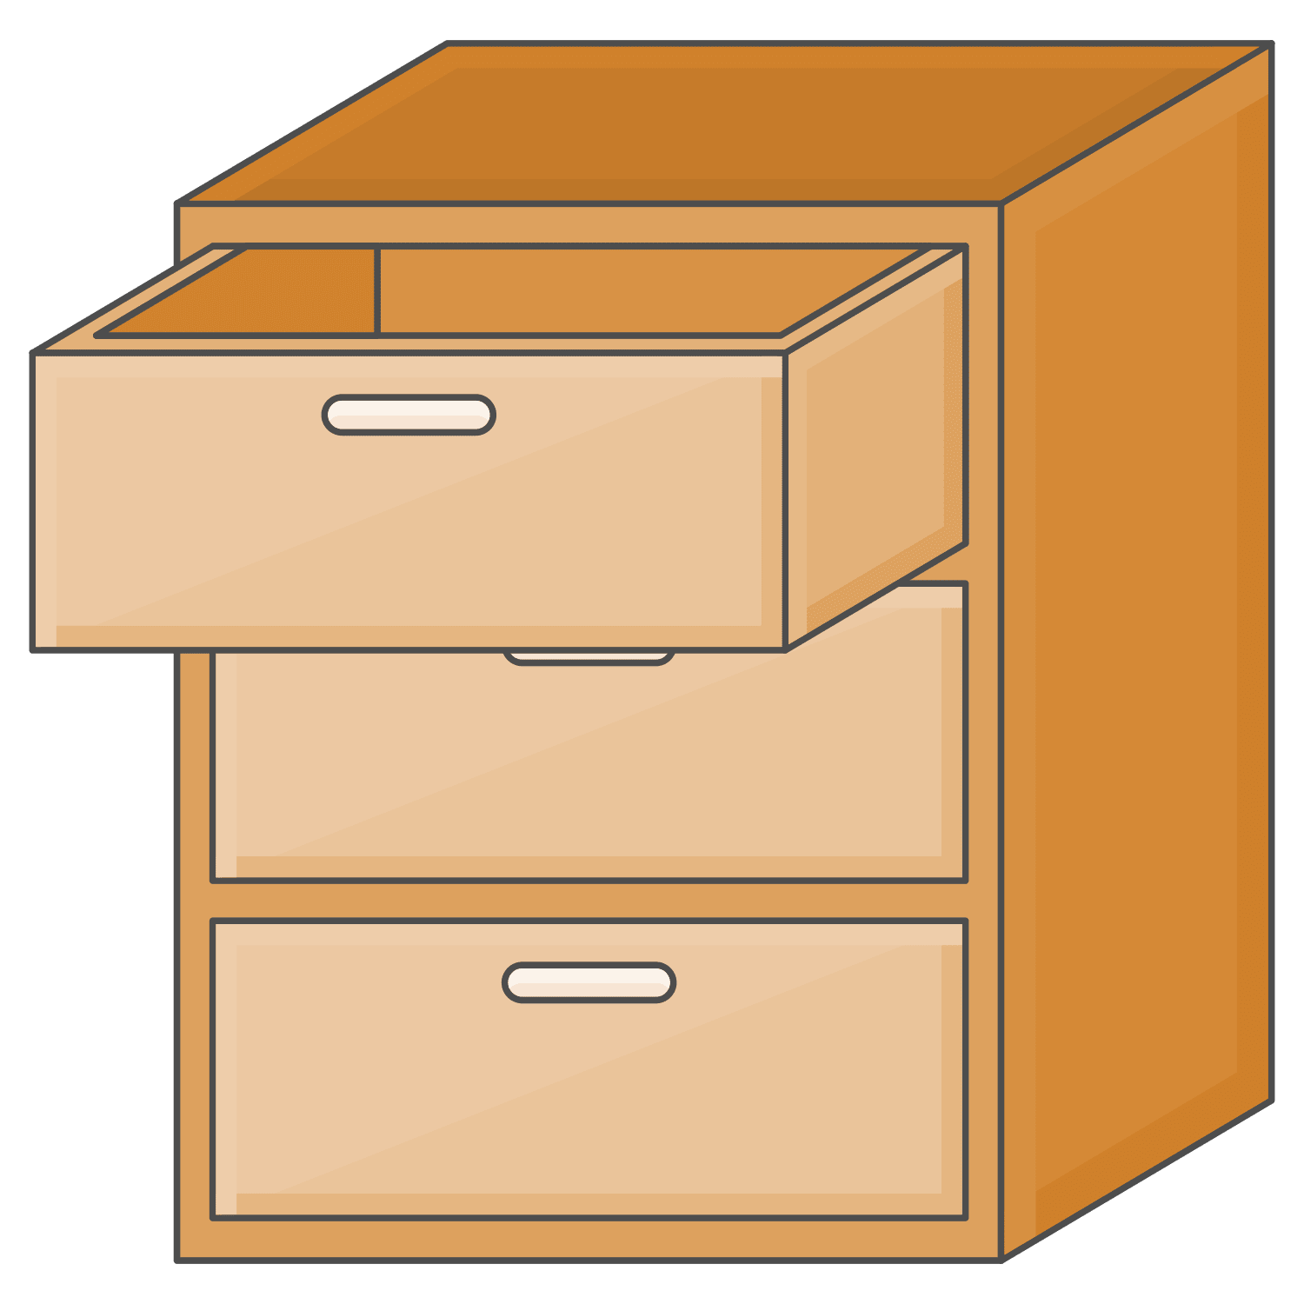
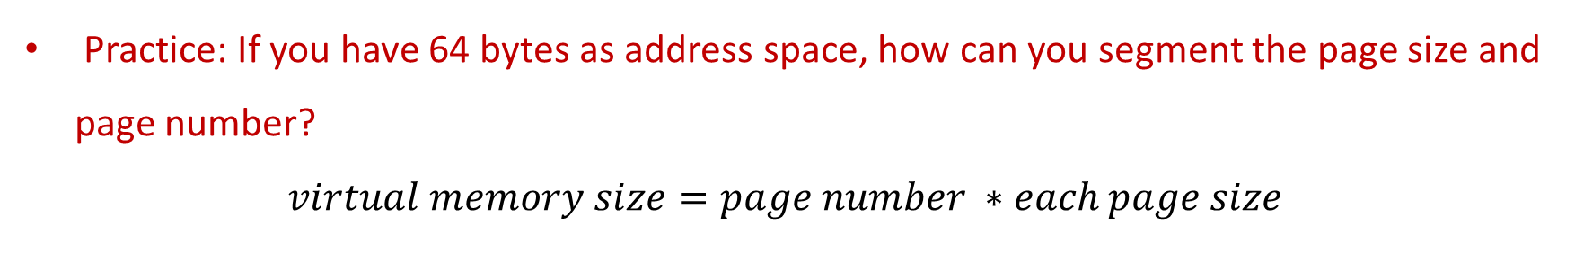
Paging Practice
Practice: If you have 64 bytes as address space, how can you segment the page size and page number?
$$virtual memory size=page number ∗each page size$$

Slide 7
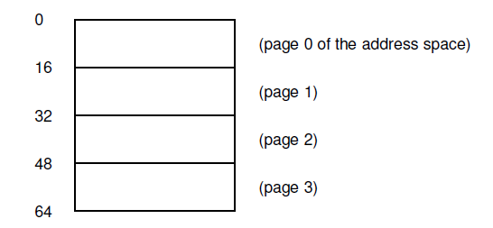
Paging of virtual memory
In the diagram, the total size of the address space is 64 bytes.
There are four pages, from VP0 to VP3. (VP: virtual page number)
Practice: What is each page size?

Slide 8

Virtual memory in the instruction
Usually, the task to access memory is in the format of instructions, something like ISA that we discussed before.
If the virtual memory address appears in an instruction, the example of the above case is shown below:
VPN: 2bits
Offset: 4 bits

Slide 9
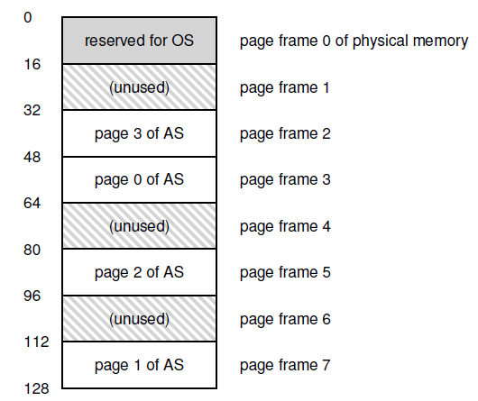
Paging of physical memory
In the diagram, there are eight pages, from PF0 to PF7. (PF: physical frame number)
Each page size is 16 bytes.
Practice: What is the total size of physical memory in this case?
VA-PA mapping: VP0-PF3, VP1-PF7, VP2-PF5, VP3-PF2
Page table saves the info to map from VA to PA.

Slide 10
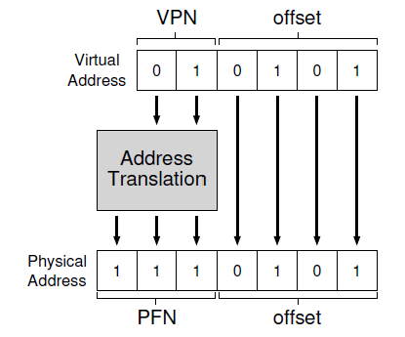
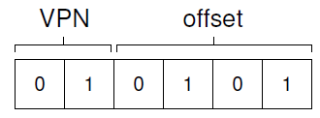
VA – PA translation
Let us use the following example to understand the VA-PA translation.
The instruction is:
The VPN structure is:
The VA-PA translation is :

Slide 11
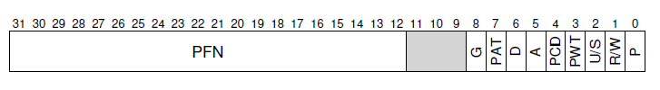
Page table entry (PTE)
Simplest page table: linear page table
Page table is an array of page table entries, one per virtual page
VPN (virtual page no.) is index into this array
Each PTE contains PFN (physical frame number) and few other bits
--- Valid bit: is this page used by process?
--- Protection bits: read/write permissions
--- Present bit: is this page in memory?
--- Dirty bit: has this page been modified?
--- Access bit: has this page been recently accessed?

Slide 12
What happens during memory access?
CPU requests code or data at a virtual address
MMU must translate VA to PA
--- First, access memory to read page table entry
--- Translate VA to PA
--- Then, access memory to fetch code /data
Paging adds overhead to memory access
Solution? A cache for VA-PA mappings

Slide 13
Translation Lookaside Buffer (TLB)
A cache of recent VA-PA mappings
To translate VA to PA, MMU first looks up TLB
If TLB hit, PA can be directly used
If TLB miss, then MMU performs additional memory accesses to “walk” page table
TLB misses are expensive (multiple memory accesses)
--- Locality of reference helps to have high hit rate
TLB entries may become invalid on context switch and change of page tables

Slide 14
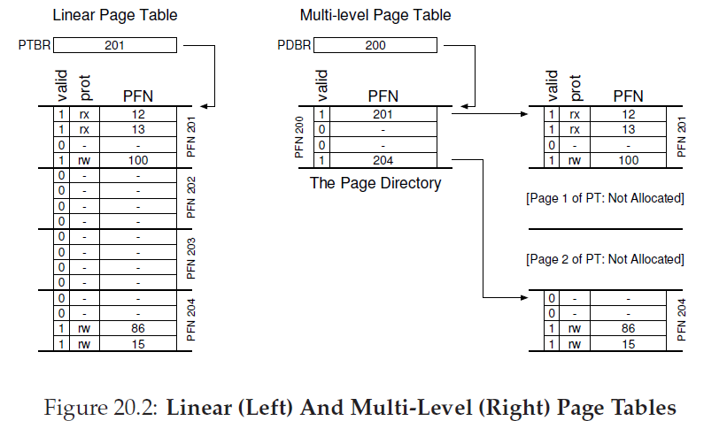
Multilevel page tables (1)
A page table is spread over many pages
An “outer” page table or page directory tracks the PFNs of the page table pages

Slide 15
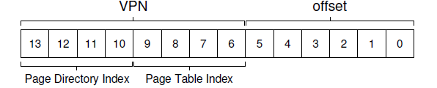
Multilevel page tables (2)
Depending on how large the page table is, we may need more than 2 levels also
--- 64-bits architectures may need 7 levels
What about address translation?
--- First few bits of VA to identify outer page table entry
--- Next few bits to index into next level of PTEs
In case of TLB miss, multiple accesses to memory required to access all the levels of page tables

